Slide 1
PIP4004: UNIVERSITY PROJECT Review-0 Presentation Dispatcher Process Monitoring Dashboard
 | Student Details
Name | Vathsala B S
Roll No | 20211CAI0203
Section | 8CAI/CST-03
Under the Supervision of,
Dr. Mohammedi Akheela Khanum
Assistant Professor
School of Computer Science and Engineering
Presidency University
Name of the Program: B. Tech
Name of the HoD: Dr. Zafar Ali Khan
Name of the Program Internship Coordinator: Dr. Sivaramakrishnan
Name of the School Project Coordinators: Dr. Sampath A K / Dr. Abdul Khadar A / Mr. Md Ziaur Rahman

Slide 2
Content
About Company or Organization
Working domain or the technology
About our team and reporting Manager
Challenges Faced in Internship
Objectives of the work
Internship Roadmap
GitHub Link

Slide 3
About Company or Organization
Company Overview
Name: Inteva Products, LLC
Founded: 2008
Headquarters: Troy, Michigan, USA
Global Presence: Nearly 30 locations across North America, South America, Europe, and Asia
Employees: Approximately 8,000
Industry: Automotive
Website: www.intevaproducts.com

Slide 4
Product Portfolio
Interior Systems:
Instrument panels
Consoles
Door trim
Cockpits
Headliners
Closure Systems:
Door latches
Compartment latches
Strikers
Electronic actuators
Motors & Electronics:
Window lift motors
Seat motors
Actuators
Electronic control units

Slide 5
Clients and Market Presence
Client Base:
Over 50 customers in more than 40 countries
Major global automakers and regional Original Equipment Manufacturers (OEMs)
Industries Served:
Automotive
Commercial vehicle
Defense
Marine
Consumer and industrial sectors

Slide 6
Working domain or the technology
Analysis of Problem Statement
A dispatcher process monitoring dashboard is designed to track and manage dispatcher processes in real-time. It ensures that system operations run smoothly, identifies failures, and provides actionable insights for maintaining efficiency.

Slide 7
Key Challenges & Issues
Lack of Real-time Monitoring: Without an efficient dashboard, tracking dispatcher processes and their statuses in real-time becomes difficult.
Error Detection and Logging: Identifying system failures or process crashes manually is inefficient.
Scalability: As the system grows, monitoring a large number of dispatcher processes becomes complex.
User Interface & Experience: The dashboard needs to be user-friendly, with clear data visualization for quick decision-making.
Security & Access Control: Unauthorized access to process logs and monitoring tools can lead to security risks.
Integration with Other Systems: The dashboard may need to fetch data from external sources via APIs.

Slide 8
Objectives of the Work
Real-time Process Monitoring: Display active, pending, and failed dispatcher processes.
Error Logging & Reporting: Provide logs and insights for debugging issues efficiently.
Scalable & Responsive UI: Ensure the dashboard works across various devices with smooth navigation.
REST API Integration: Allow data fetching from various sources and ensure smooth communication between frontend and backend.

Slide 9
Analysis of Problem Statement
Software components:
1. React (Frontend – User Interface)
React is used to create an interactive and responsive dashboard where users can monitor dispatcher processes in real-time.
It fetches data from the backend using REST API, dynamically updates process statuses, and displays running, pending, or failed processes using tables.
2. Node.js (Backend – Server Logic)
Node.js acts as the backend runtime, handling client requests and processing dispatcher data asynchronously.

Slide 10
Analysis of Problem Statement
3. Express.js (Backend – REST API Framework)
Express.js simplifies API development by handling HTTP requests for fetching dispatcher process data.
4. REST API (Communication Between Frontend & Backend)
REST API enables React to communicate with the backend by sending HTTP requests to retrieve dispatcher process statuses.
It ensures smooth data exchange in JSON format, allowing real-time updates on the monitoring dashboard.

Slide 11
Workflow
Steps:
React UI makes an API request.
Express.js processes the request in Node.js
REST API fetches the dispatcher data.
React updates the dashboard with the latest process statuses.

Slide 12
About your team and reporting Manager
IT Infrastructure Support Overview
Global & Local IT Support:
Office Services:
Installation, support, and maintenance of end-user devices (computers, laptops, printers, etc.)
Shopfloor Services:
Support for shopfloor devices (control panels, handheld scanners, barcode printers, etc.)
Systems:
Installation, support, and maintenance of servers (File/Print, Email, Application, Database)

Slide 13
IT Infrastructure & Support Functions
Core IT Functions:
Network:
LAN, WAN, internet connections, remote access, and third-party network support
Security:
System, network, mobile device security, antivirus protection, firewalls
Business Continuity:
Backup/Restore, Disaster Recovery, monitoring
Communications:
PBX, telephone/mobile communications, VoIP, teleconferencing services
Service Desk / Help Desk:
Incident registration, escalation, and resolution

Slide 14
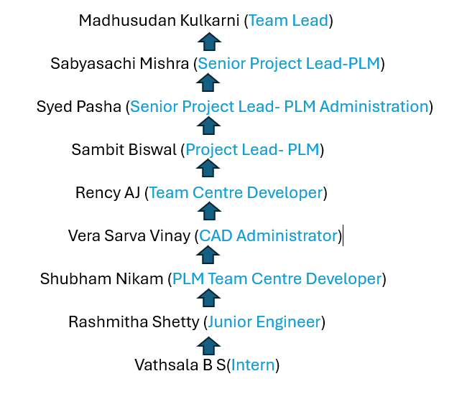
Team Members

Slide 15
Challenges Faced in Internship
Challenges in Searching for an Internship
1. Finding the Right Opportunities:
Competition: High competition for popular roles.
Limited Availability: Some fields have fewer internship opportunities.
Application Process: Time-consuming with tailored resumes and cover letters for each application.
2. Cracking the Interview:
Technical Tests: Coding assessments can be intimidating.
Behavioral Questions: You must demonstrate teamwork, problem-solving, and conflict resolution.
Nervousness: The pressure to perform can affect confidence and performance.
3. Adjusting to the Team:
Work Culture: Adapting to different workplace environments and dynamics.
Team Communication: Learning to collaborate with varying communication styles.
Technical Environment: Quickly adapting to new tools and technologies.

Slide 16
Internship Road Map
Note: Write in the below table what u will be achieving in each review
Review 0
Evaluate early performance integration and understanding of tasks.
Review 1
Review 2
Review 3

Slide 17
GitHub Link
Link: https://github.com/vathsalabs/Internship-Project.git

Slide 18


